Slide 1
Recommender Networks

Slide 2
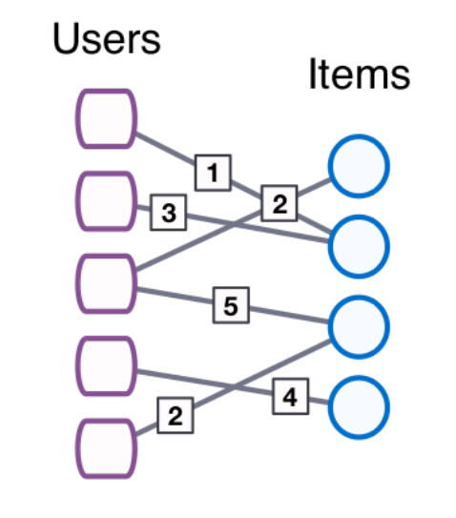
What Is a Recommender Network?
Bipartite networks. Most recommender systems such as Amazon’s system and Netflix’s system are based on bipartite networks called recommender networks or user-item networks.
Ratings. Such networks are augmented with labeling all edges by numbers: a number assigned to an edge connecting a user and an item is a rating given by the user to the item.

Slide 3
Collaborative Filtering
Recommender systems are based on a technique called collaborative filtering. The underlying recommender network is used to make a prediction for a given user: which of the items will the user like?
There are two forms of collaborative filtering:
user-to-user form;
item-to-item form.
?

Slide 4
User-to-User Collaborative Filtering

Slide 5
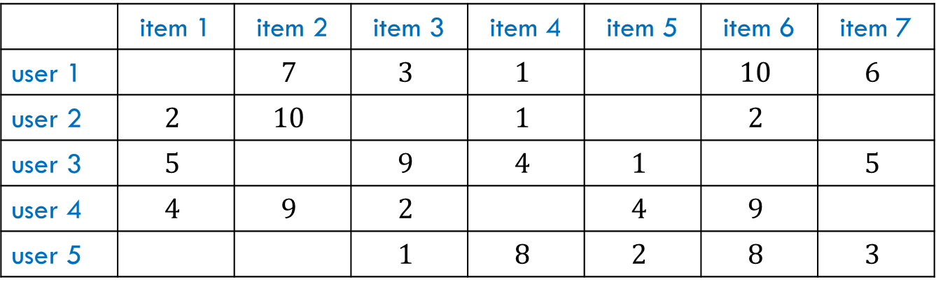

Recommender Networks in Table Form
The table below represents a recommender network, where ratings are integers from $1$ to $10$.
Remark. A typical table is “sparse”: most entries are empty.
 | item 1 | item 2 | item 3 | item 4 | item 5 | item 6 | item 7
user 1 |  | $$7$$ | $$3$$ | $$1$$ |  | $$10$$ | $$6$$
user 2 | $$2$$ | $$10$$ |  | $$1$$ |  | $$2$$
user 3 | $$5$$ |  | $$9$$ | $$4$$ | $$1$$ |  | $$5$$
user 4 | $$4$$ | $$9$$ | $$2$$ |  | $$4$$ | $$9$$
user 5 |  |  | $$1$$ | $$8$$ | $$2$$ | $$8$$ | $$3$$

Slide 6

Indirect Ratings
Entries in the table may have various interpretation, not necessarily explicit ratings given by users. Here is just one example. The items are TV channels and the $(i,j)$-entry is an amount of time spent by user $i$ watching channel $j$.
number of hours per week

Slide 7


Normalized Ratings
Typically, there is a big difference between users in their average ratings. Therefore, it is common to normalize entries in recommender tables. For example, an entry can be the rating minus the average rating of a given user. An empty entry is replaced with $0$.
 | item 1 | item 2 | item 3 | item 4 | item 5 | item 6 | item 7
user 1 | $$0$$ | $$1.6$$ | $$−2.4$$ | $$−4.4$$ | $$0$$ | $$4.6$$ | $$0.6$$
user 2 | $$−1.75$$ | $$6.25$$ | $$0$$ | $$−2.75$$ | $$0$$ | $$−1.75$$ | $$0$$
user 3 | $$0.2$$ | $$0$$ | $$4.2$$ | $$−0.8$$ | $$−3.8$$ | $$0$$ | $$0.2$$
user 4 | $$−1.6$$ | $$3.4$$ | $$−3.6$$ | $$0$$ | $$−1.6$$ | $$3.4$$ | $$0$$
user 5 | $$0$$ | $$0$$ | $$−3.4$$ | $$3.6$$ | $$−2.4$$ | $$3.6$$ | $$−1.4$$

Slide 8

Profiles
Profiles. Every row is thought of as a user’s profile. The profile of a user expresses the user’s opinions about items (the user’s “tastes”).
 | item 1 | item 2 | item 3 | item 4 | item 5 | item 6 | item 7
user 1 | $$0$$ | $$1.6$$ | $$−2.4$$ | $$−4.4$$ | $$0$$ | $$4.6$$ | $$0.6$$
user 2 | $$−1.75$$ | $$6.25$$ | $$0$$ | $$−2.75$$ | $$0$$ | $$−1.75$$ | $$0$$
user 3 | $$0.2$$ | $$0$$ | $$4.2$$ | $$−0.8$$ | $$−3.8$$ | $$0$$ | $$0.2$$
user 4 | $$−1.6$$ | $$3.4$$ | $$−3.6$$ | $$0$$ | $$−1.6$$ | $$3.4$$ | $$0$$
user 5 | $$0$$ | $$0$$ | $$−3.4$$ | $$3.6$$ | $$−2.4$$ | $$3.6$$ | $$−1.4$$
profile of
user 1

Slide 9
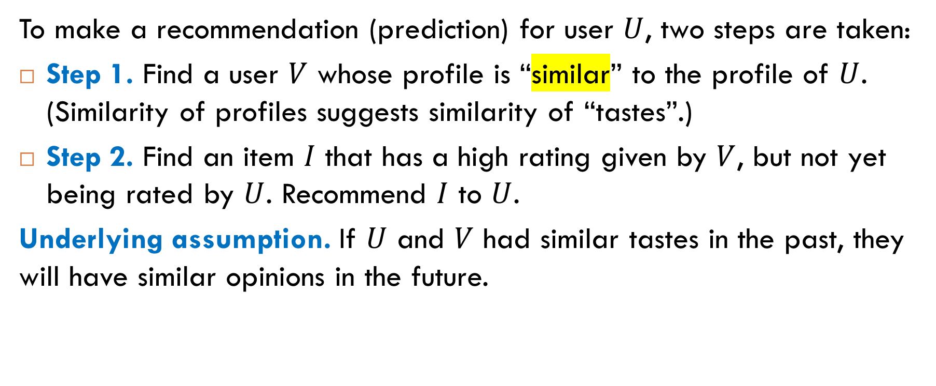
User-to-User Collaborative Filtering: Idea
To make a recommendation (prediction) for user $U$, two steps are taken:
Step 1. Find a user $V$ whose profile is “similar” to the profile of $U$. (Similarity of profiles suggests similarity of “tastes”.)
Step 2. Find an item $I$ that has a high rating given by $V$, but not yet being rated by $U$. Recommend $I$ to $U$.
Underlying assumption. If $U$ and $V$ had similar tastes in the past, they will have similar opinions in the future.
Key point: how to define this similarity?

Slide 10
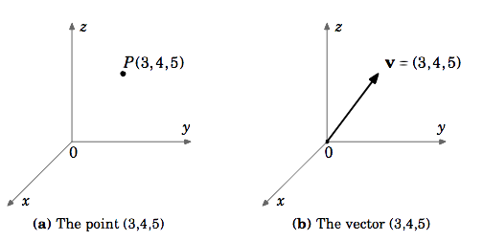

Similarity in Euclidean Space
A profile is a sequence of real numbers. This sequence can be viewed as a point in Euclidean space $ℝ^{n}$ or, equivalently, as a vector.
Two approaches:
similarity between points is the Euclidean distance between them;
similarity between vectors is the cosine similarity between them.

Slide 11
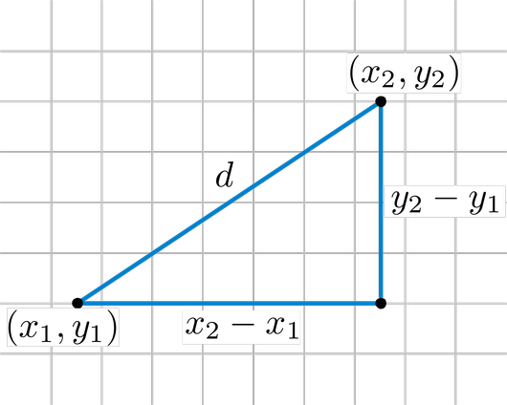

Euclidean Distance
The Euclidean distance between points
$$X=\left(x_{1},…, x_{n}\right)$$
$$Y=\left(y_{1},…, y_{n}\right)$$
is defined by
$$d\left(X,Y\right)=\sqrt{{\left(x_{1}−y_{1}\right)}^{2}+…+{\left(x_{n}−y_{n}\right)}^{2}.}$$
Question. Is the Euclidean distance a good measure for similarity between profiles?

Slide 12
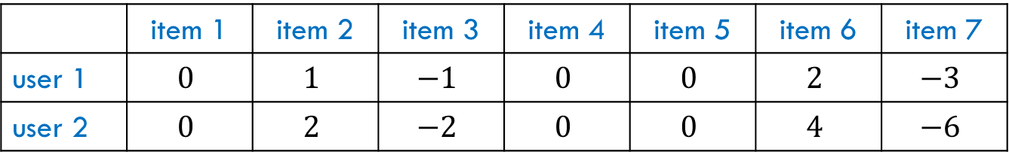
Not a Good Measure
The Euclidean distance has several disadvantages as a measure of similarity between profiles. Here is an example that illustrates one of them.
The two users evaluate the items in essentially the same way: the ratings given by user 2 is, in fact, an amplified version of the ratings given by user 1. However, the distance between such profiles can be large.
 | item 1 | item 2 | item 3 | item 4 | item 5 | item 6 | item 7
user 1 | $$0$$ | $$1$$ | $$−1$$ | $$0$$ | $$0$$ | $$2$$ | $$−3$$
user 2 | $$0$$ | $$2$$ | $$−2$$ | $$0$$ | $$0$$ | $$4$$ | $$−6$$

Slide 13
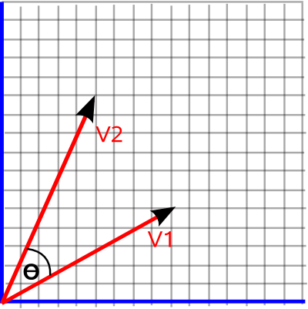


Another Measure of Similarity
The similarity between vectors
$$\vec{X}=\left(x_{1},…, x_{n}\right)$$
$$\vec{Y}=\left(y_{1},…, y_{n}\right)$$
is captured by the cosine of the angle between them. If the angle is small, then its cosine is close to $1$, which means that the vectors are similar.
Note. In the example in the previous slide, the angle between the vectors is $0$ and its cosine is $1$. Therefore, we have maximum similarity.

Slide 14
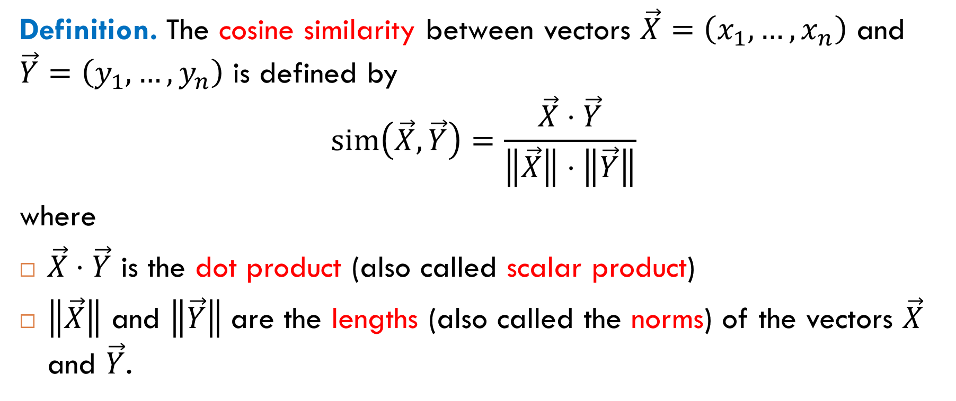
Cosine Similarity
Definition. The cosine similarity between vectors $\vec{X}=\left(x_{1},…, x_{n}\right)$ and $\vec{Y}=\left(y_{1},…, y_{n}\right)$ is defined by
$$sim\left(\vec{X},\vec{Y}\right)=\frac{\vec{X}⋅\vec{Y}}{\left\|\vec{X}\right\|⋅\left\|\vec{Y}\right\|}$$
where
$\vec{X}⋅\vec{Y}$ is the dot product (also called scalar product)
$\left\|\vec{X}\right\|$ and $\left\|\vec{Y}\right\|$are the lengths (also called the norms) of the vectors $\vec{X}$ and $\vec{Y}$.

Slide 15

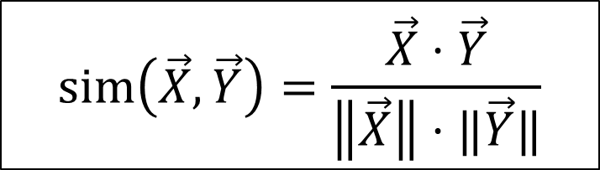
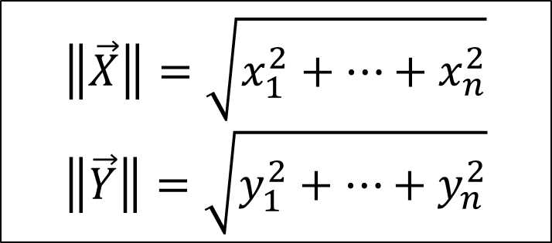
$$sim\left(\vec{X},\vec{Y}\right)=\frac{\vec{X}⋅\vec{Y}}{\left\|\vec{X}\right\|⋅‖\vec{Y}‖}$$
cosine similarity
dot product
$$\vec{X}⋅\vec{Y}=x_{1}y_{1}+…+x_{n}y_{n}$$
$$\left\|\vec{X}\right\|=\sqrt{x_{1}^{2}+…+x_{n}^{2}}$$
$$\left\|\vec{Y}\right\|=\sqrt{y_{1}^{2}+…+y_{n}^{2}}$$
lengths

Slide 16


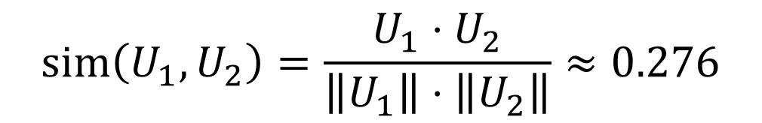


Cosine Similarity Between User 1 and User 2
$$\left\|U_{1}\right\|≈7.014$$
$$sim\left(U_{1},U_{2}\right)=\frac{U_{1}⋅U_{2}}{\left\|U_{1}\right\|⋅\left\|U_{2}\right\|}≈0.276$$
$$\left\|U_{2}\right\|≈7.263$$
$$U_{1}⋅U_{2}=14.05$$
angle $≈{74}^{∘}$

Slide 17
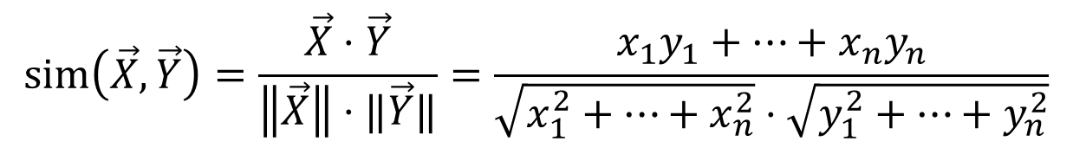
Who Is Most Similar to User 1?
$$sim\left(\vec{X},\vec{Y}\right)=\frac{\vec{X}⋅\vec{Y}}{\left\|\vec{X}\right\|⋅‖\vec{Y}‖}=\frac{x_{1}y_{1}+…+x_{n}y_{n}}{\sqrt{x_{1}^{2}+…+x_{n}^{2}}⋅\sqrt{y_{1}^{2}+…+y_{n}^{2}}}$$
https://www.omnicalculator.com/math/cosine-similarity

Slide 18


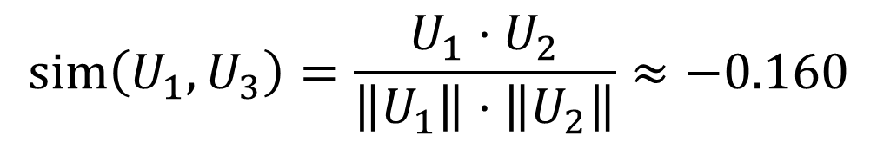


Cosine Similarity Between User 1 and User 3
$$\left\|U_{1}\right\|≈7.014$$
$$sim\left(U_{1},U_{3}\right)=\frac{U_{1}⋅U_{2}}{\left\|U_{1}\right\|⋅\left\|U_{2}\right\|}≈−0.160$$
$$\left\|U_{3}\right\|≈5.727$$
$$U_{1}⋅U_{3}=−6.44$$
angle $≈{99}^{∘}$

Slide 19

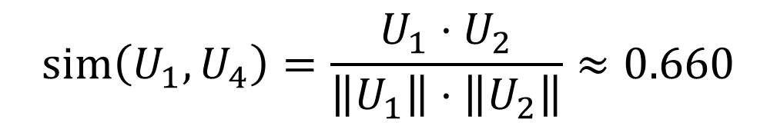


Cosine Similarity Between User 1 and User 4
$$\left\|U_{1}\right\|≈7.014$$
$$sim\left(U_{1},U_{4}\right)=\frac{U_{1}⋅U_{2}}{\left\|U_{1}\right\|⋅\left\|U_{2}\right\|}≈0.660$$
$$\left\|U_{4}\right\|≈6.419$$
$$U_{1}⋅U_{4}=29.72$$
angle $≈{49}^{∘}$

Slide 20

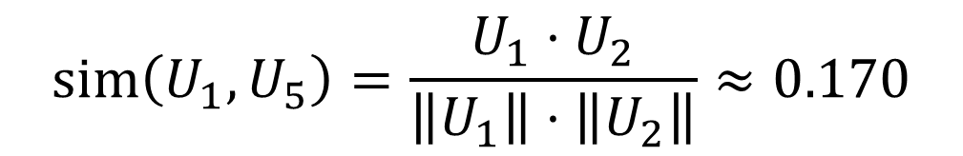


Cosine Similarity Between User 1 and User 5
$$\left\|U_{1}\right\|≈7.014$$
$$sim\left(U_{1},U_{5}\right)=\frac{U_{1}⋅U_{2}}{\left\|U_{1}\right\|⋅\left\|U_{2}\right\|}≈0.170$$
$$\left\|U_{5}\right\|≈6.72$$
$$U_{1}⋅U_{5}=8.04$$
angle $≈{80}^{∘}$

Slide 21
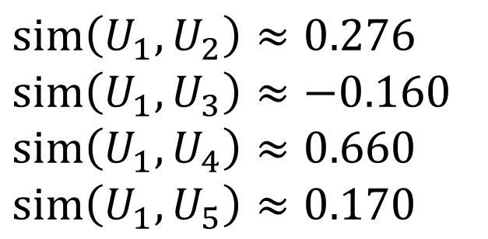
Similarity Between User 1 and the Other Users
$$sim\left(U_{1},U_{2}\right)≈0.276$$
$$sim\left(U_{1},U_{3}\right)≈−0.160$$
$$sim\left(U_{1},U_{4}\right)≈0.660$$
$$sim\left(U_{1},U_{5}\right)≈0.170$$
highest similarity

Slide 22
Item-to-Item Collaborative Filtering

Slide 23
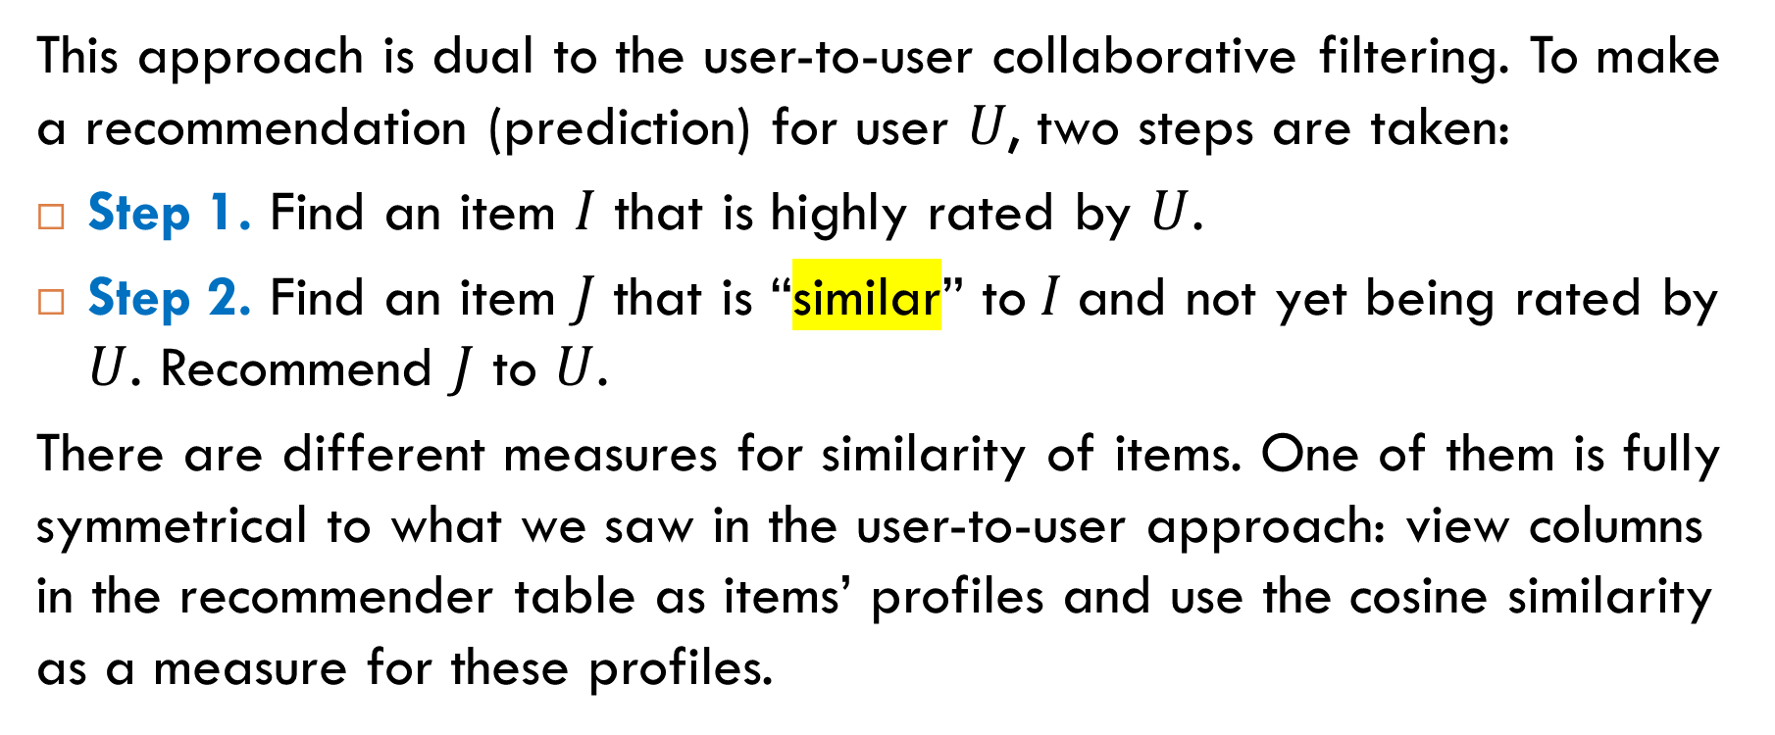
Idea
This approach is dual to the user-to-user collaborative filtering. To make a recommendation (prediction) for user 𝑈, two steps are taken:
Step 1. Find an item $I$ that is highly rated by $U$.
Step 2. Find an item $J$ that is “similar” to$I$and not yet being rated by $U$. Recommend $J$ to $U$.
There are different measures for similarity of items. One of them is fully symmetrical to what we saw in the user-to-user approach: view columns in the recommender table as items’ profiles and use the cosine similarity as a measure for these profiles.

Slide 24
Recommendation for User 1: Step 1
User 1 gave the highest rating to item 6. Here is the profile of this item.

Slide 25
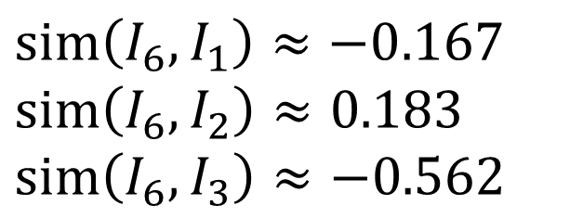
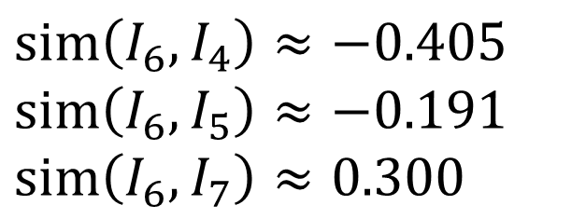
Recommendation for User 1: Step 2
$$sim\left(I_{6},I_{1}\right)≈−0.167$$
$$sim\left(I_{6},I_{2}\right)≈0.183$$
$$sim\left(I_{6},I_{3}\right)≈−0.562$$
$$sim\left(I_{6},I_{4}\right)≈−0.405$$
$$sim\left(I_{6},I_{5}\right)≈−0.191$$
$$sim\left(I_{6},I_{7}\right)≈0.300$$
Recommend Item 7 to User 1

Slide 26
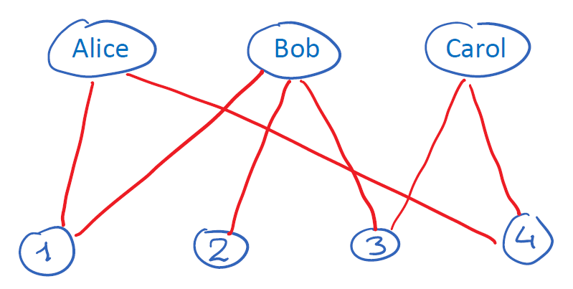
Exercise
Suppose we have a user-item bipartite graph without ratings. For example,
Alice bought items 1 and 4;
Bob bought items 1, 2, and 3;
Carol bought items 3 and 4.
Suggest a method of recommendation.

Slide 27

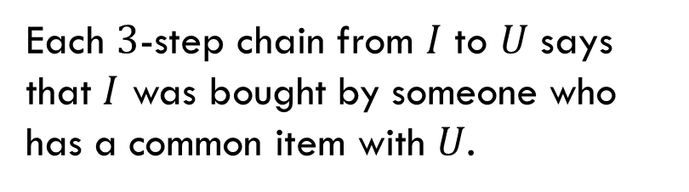
Possible Solution
Recommendation for user $U$: Find an item $I$ such that
There is no edge between $U$ and $I$.
The item $I$ has the maximum number of $3$-step chains to $U$.
Recommend $I$ to $U$.
Each $3$-step chain from $I$ to $U$ says that $I$ was bought by someone who has a common item with $U$.

Slide 28

Example
Recommendation for Alice
Item 2 has one $3$-step chain to Alice.
Item 3 has two $3$-step chains to Alice.
Therefore, item 3 is recommended to Alice.

Slide 29

Reading
Section 3.3.2

